Slide 1


eEVA Data Generation and Results Analysis v2.0
Team Members: Andy Regueira, Emmanuel Henley Product Owner: Dr. Christine Lisetti Mentors: Stephanie Lunn (eEVA), Mohsen Taheri (Senior Design)
Instructor: Dr. Masoud Sadjadi School of Computing and Information Sciences Florida International University
Final Presentation
Spring 2017
Notes:
Welcome to the eEVA Data Generation and Results Analysis version 2.0 introductory video.
The team members for this project include Andy Reguiera and Emmanuel Henley.
The Product owner of this project is Dr. Christine Lisetti,
With mentors Stephanie Lunn with eEVA and Mohsen Taheri with senior design.
Under instruction of Dr. Masoud Sadjadi

Slide 2
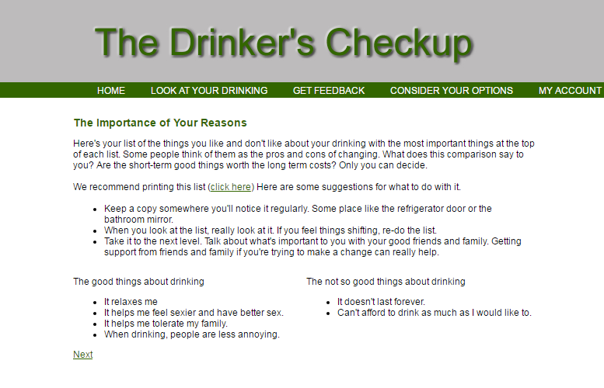
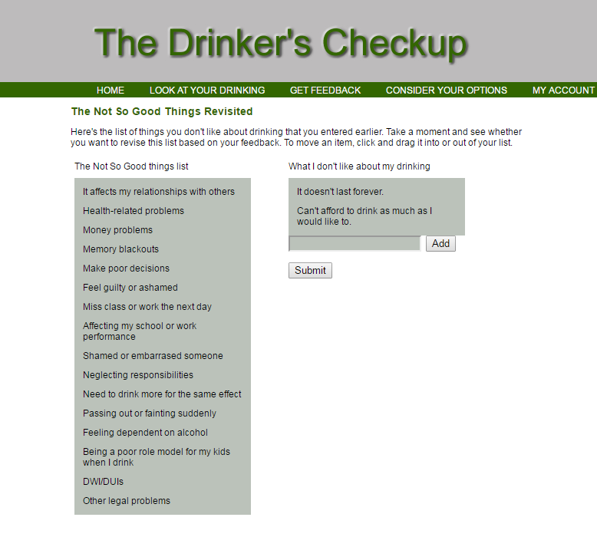
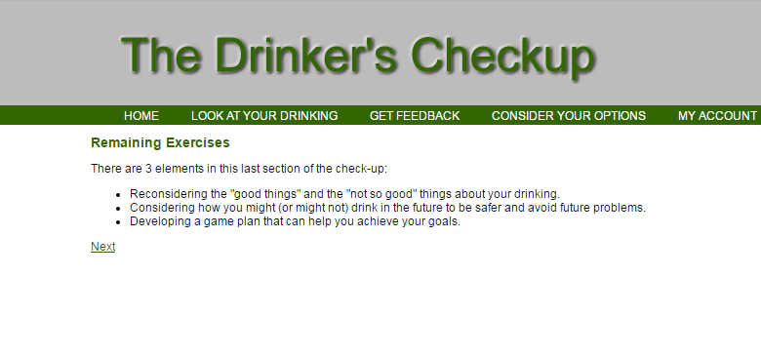
Original Drinker’s Checkup (Hester, Squires, Delaney, 2005)
Notes:
Alcohol abuse is a social epidemic where many people who suffer are unaware they even have a problem.
It has been proven through research that short bursts of brief motivational interventions or BMI’s can help an individual realize the situation is out of control(Miller, Wilbourne, & Hettema, 2003).
Currently the original online version, Drinker’s Checkup by Hester, Squires and Delany heavily focused on text and the results are at times hard to decipher.
Requirements per Mohsen Taheri
10 seconds.
Introduce the problem that the whole project (in all versions) tackles with GIF or screenshot.

Slide 3
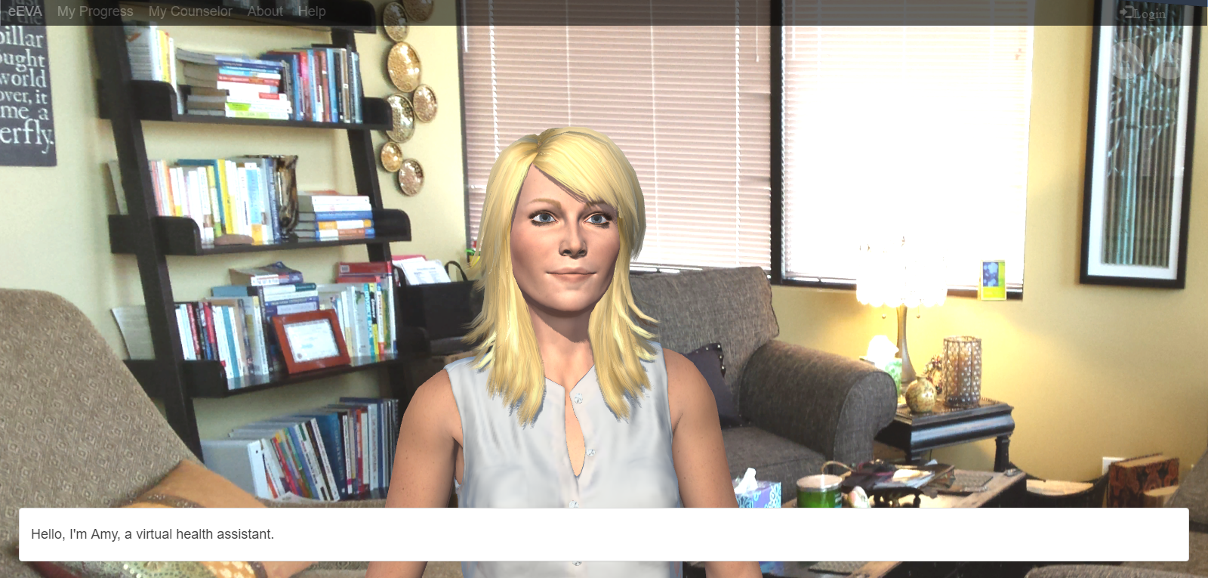
Current Version 2.0
Notes:
Through the use of an empathic embodied virtual agent acting as an administering counselor of this version of the DCU, and allowing the user to select the counselor in which they feel the most comfortable with we can improve the user’s engagement and incidentally increase the chances of completion of the program from that of the original text based dcu.
20 seconds.
Introduce the problem that the your project (in new version) tackles with GIF or screenshot.

Slide 4
Example Use Case (EditDCU_RemainingExercises #389)
Use Case
Name |  | #436 EditDCU_Resources
Description |  | After the user has completed the section “Game Plan Overview”, the counselor needs to present the user with a compilation of resources that will be helpful in achieving the goals they outlined in a previous section. The administrator needs to be able to edit this content to be able to give the counselor the ability to present these resources, as well as, provide the user the ability to access the source of these resources (via links).
Actor |  | eEVA Administrator
Preconditions |  | Administrator is logged in and is editing “Resources” form inside the Survey Editor
Flow of Events
 | eEVA Administrator |  | System
1 | eEVA Administrator clicks on “Edit” on “Resources” form in the “Survey Editor” |  | surveyView registers request and linkToEditor(Resources) contacts surveyController
2 | eEVA Administrator clicks button to add “Content” element |  | surveyView registers request and content_create() is called via editor controller and new Content element appears in editor view
3 | eEVA Administrator enters content (html, css, and js code) for the corresponding question |  | surveyView registers request via editor controller
4 | eEVA Administrator clicks button to add “FeedbackList” element |  | surveyView registers request and feedbackList_create() via editor controller and new FeedbackList element appears in editor view
5 | eEVA Administrator enters counselor’s speech for “Resource” page into the FeedbackList |  | surveyView registers request via editor controller
6 | eEVA Administrator clicks “Update” button |  | editorView calls submit to editorController and editorController sends the data via sendData(form) to the elementModel. Content is updated and editor view stays present
Each use case consist of the following:
A description – what is the use for
Actor(s) – who are the active participants in this use case
Preconditions – what conditions must be met prior to the flow of events to take place
Flow of events – details the necessary steps from both the user and system necessary to complete the associated user story
Notes:
This is a sample use case for the user story EditDCU_RemainingExercises #389. The majority of use cases for the user stories we worked on had a similar flow.
Basically the administrator needs to be able to edit a section of the eEVA’s intervention to present the user with information as well as feed the counselor his/her speech.
Each use case consist of the following:
A description – what is the use for
Actor(s) – who are the active participants in this use case
Preconditions – what conditions must be met prior to the flow of events to take place
Flow of events – details the necessary steps from both the user and system necessary to complete the associated user story
5 seconds
Show the Use Case Diagram for the whole project. Highlight your use cases.

Slide 5
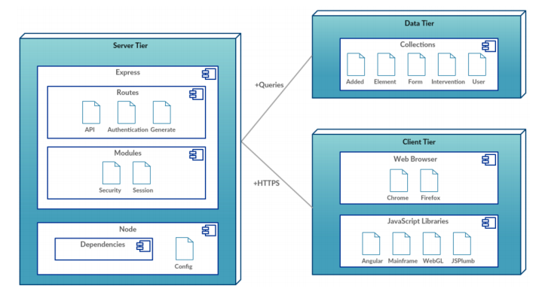
System Design: Deployment Diagram
Notes:
The framework for the system was created using a MEAN Stack, by the Affective Social Computing Laboratory (ASCL).
The eEVA system uses a Model View Controller architecture, which utilizes a Mongo database that stores the data in the tables mentioned (added, element, form, intervention and user).
Express contains both Routes and Modules in the Server Tier. Then Node is used as the framework, consisting of the server configuration and dependencies.
The client side tier contains the views that the user interacts with.
The site can be launched via Chrome or Firefox, with the necessary Javascript libraries rendering the WebGL avatar.
20 seconds
System design: Highlight the parts that you contributed to them.
1. System decomposition; identify the architecture patterns used
2. System deployment – h/w and s/w requirements

Slide 6
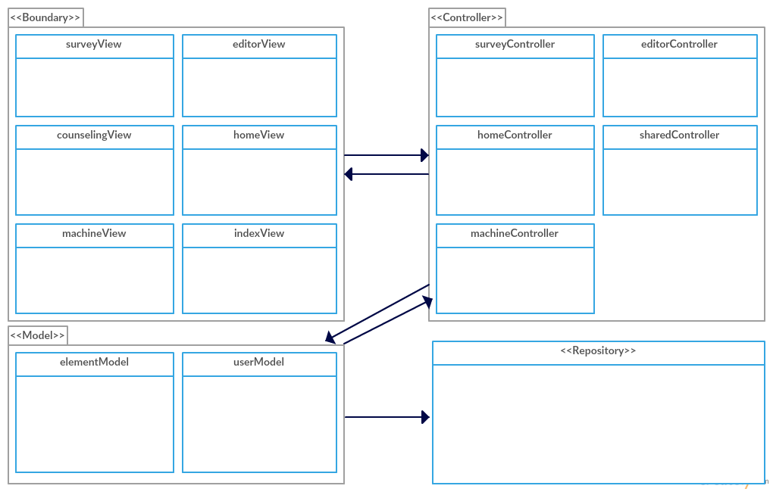
Minimal Class Diagram
Model View Controller
Model – responsible for managing the data, logic, and rules of the eEVA
View generates new output to the user based on changes in the model
Controller sends commands to the model or the view to update its presentation
Repository stores the data from the eEVA system
Notes:
We mostly implemented items in the survey editor and state machine, which were rendered primarily in the surveyView and editorView. These were controlled by the respective surveyController and editor Controller, which used updated the content into the repository. However, the other views mentioned like the counseling View were necessary to display the modified content to system users as well.
10 seconds.Minimal class diagram. Highlight the classes that you created/modified
Identify the design patterns used (one or more slides).

Slide 7
User Stories
#344 InSessionCounselorSelection
#387 EditDCU_RatingProsAndCons
#419 EditDCU_GameplanOverview
#425 EditDCU_AddDirectionalArrows
#436 EditDCU_Resources
Notes:
5 seconds.
List the user stories that you worked on them.(put in order of importance). Stay focused on the parts that you have been working.

Slide 8
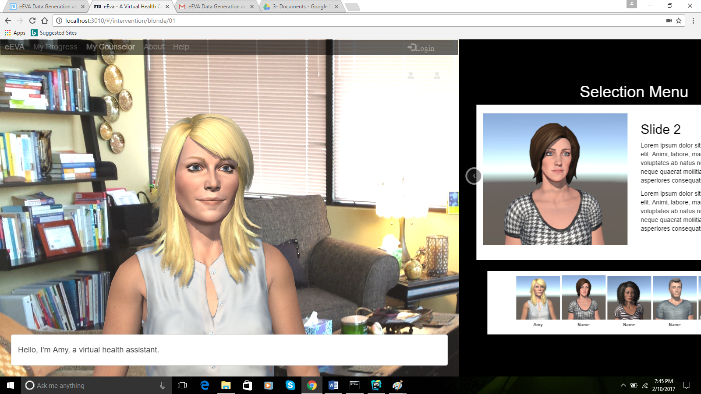
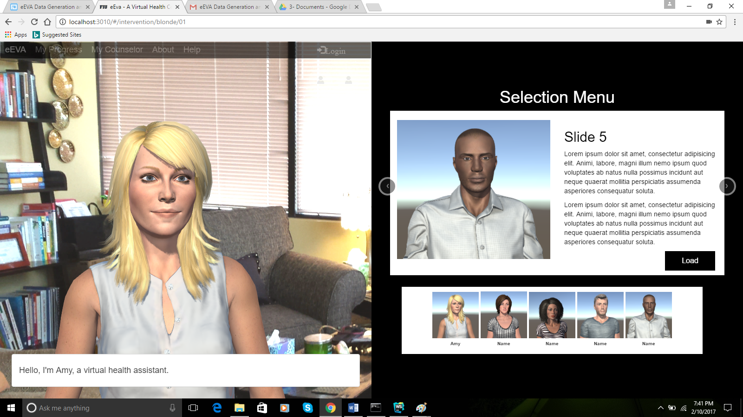
#344 InSessionCounselorSelection
Allows the user to change counselor while in session
All available counselors are presented to the user as thumbnails
The in session counselor selection menu expands from right to left, pushing the counseling view to half screen
Each counselor has a name and a brief description
Notes:
The most impactful user story that we worked on during the eEva project was #344 InSessionCounselorSelection. This user story allows the user to change their selected counselor while currently in a counseling session. This menu is not obstructive to the current session. The user is presented with all available counseling in which they can choose from. Each counselor has a name as well as a brief description.
60 seconds
The tile of user story
The most important user story you worked on it. You have to describe this one very well and be proud of that.
Please present and show the complexity of your work, code, algorithms, and technical challenges and technologies you have used. (you could use screenshot if you want. Visual presentations are better than text presentation)
Go into the details of the most important/significant tasks using bullet lists or visual graphs or state chart diagram
Sequence Diagram for this user story is mandatory (in another separate page if required)
Demo using screenshots or GIF (in another separate page if required)

Slide 9
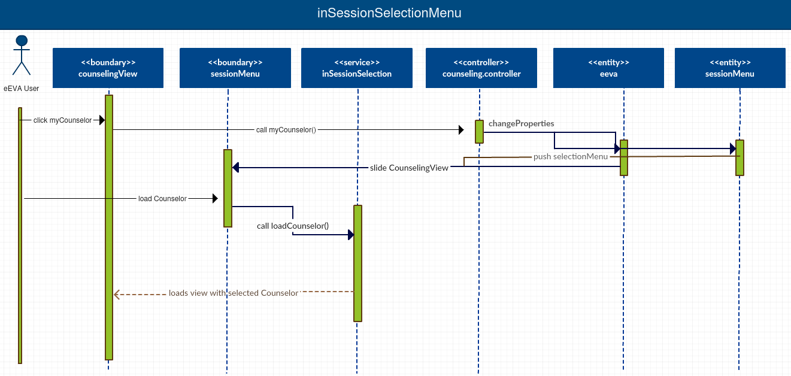
#344 InSessionCounselorSelection (Sequence Diagram)
Notes:
The counseling view has a width of 100%, where as the in session menu has a width of 0% making it hidden.
When the user clicks MyCounselors in the navigation bar, a function in the counseling controller changes the ng-class for both counseling view and in session menu.
In essence, it switches classes and the counseling view resizes to 50% width as well as the in session menu creating a smooth transition.
The user may also load a counselor of their choice, which will reload the page with the selected counselor.

Slide 10
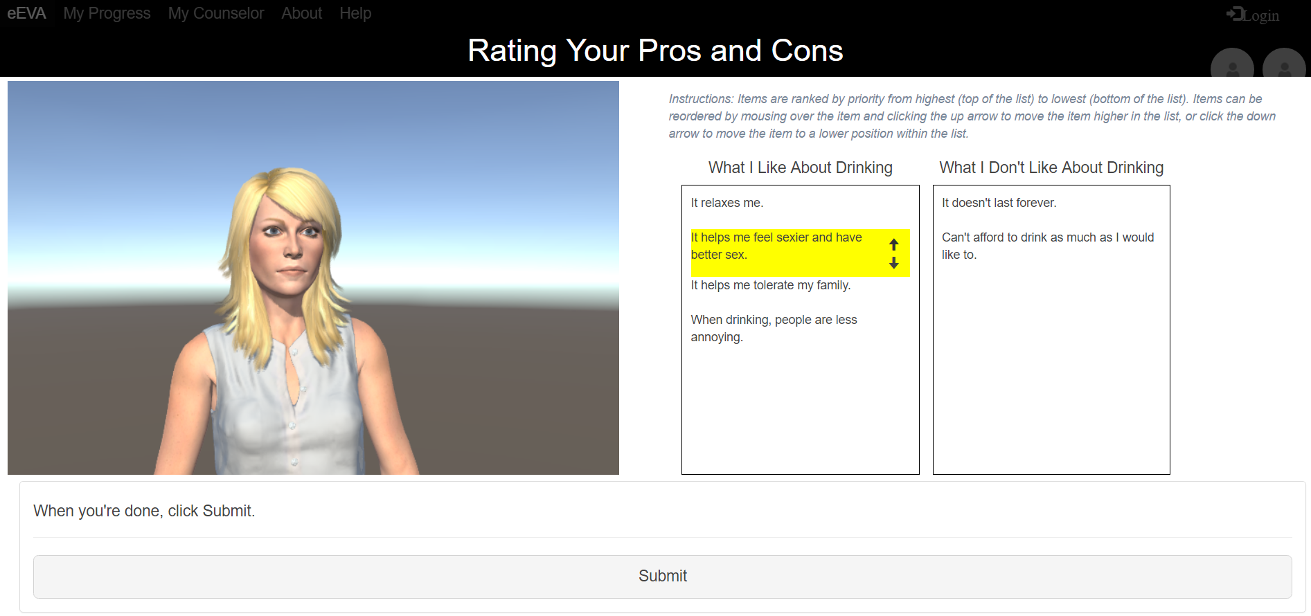
#387 EditDCU_RatingProsAndCons
Notes:
The counselor remains at half screen at the start this section.
The counselor introduces the purpose of this section and two text boxes display (What I Like About Drinking and What I Don’t Like About Drinking) containing how the user answered the previous sections What I like about Drinking and What I Don’t Like About Drinking.
The user is allowed the opportunity to rate their responses using provided up and down arrows based on the importance of that item to the user.
20 seconds
The tile of user story
Please present and show the complexity of your work, code, algorithms, and technical challenges and technologies you have used. (you could use screenshot if you want. Visual presentations are better than text presentation) - Go into the details of the most important/significant tasks using bullet lists or visual graphs or state chart diagram - Demo using screenshots or GIF (in another separate page if required)
Sequence Diagram for this user story is optional

Slide 11
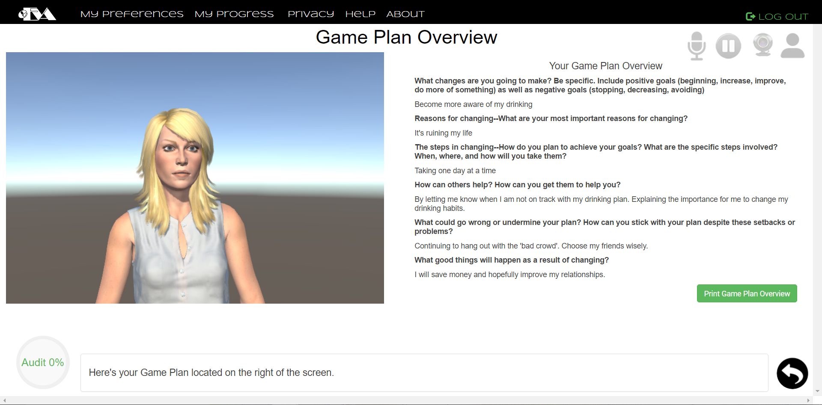
#419 EditDCU_GameplanOverview
Notes:
Again, the counselor remains toggled at half screen.
This section shows the questions that were asked in the Game Plan section of the DCU and also includes the user’s responses to the Game Plan section of the DCU.
This section provides a print button that will allow the use to print their responses for future reference.
20 seconds
The tile of user story
Please present and show the complexity of your work, code, algorithms, and technical challenges and technologies you have used. (you could use screenshot if you want. Visual presentations are better than text presentation) - Go into the details of the most important/significant tasks using bullet lists or visual graphs or state chart diagram - Demo using screenshots or GIF (in another separate page if required)
Sequence Diagram for this user story is optional

Slide 12
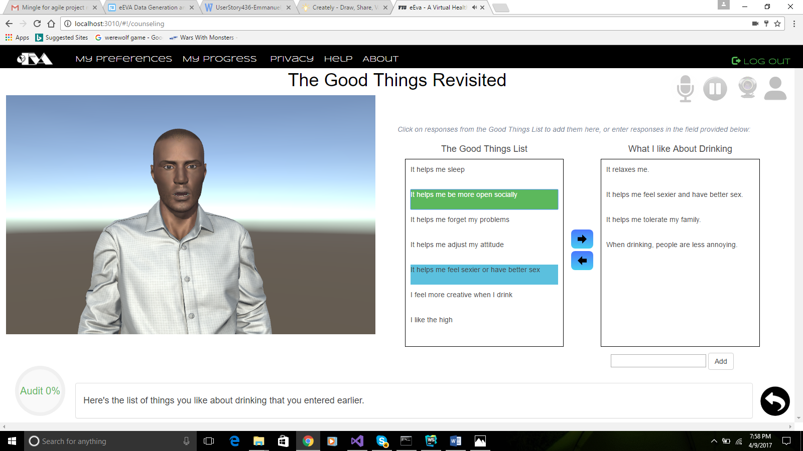
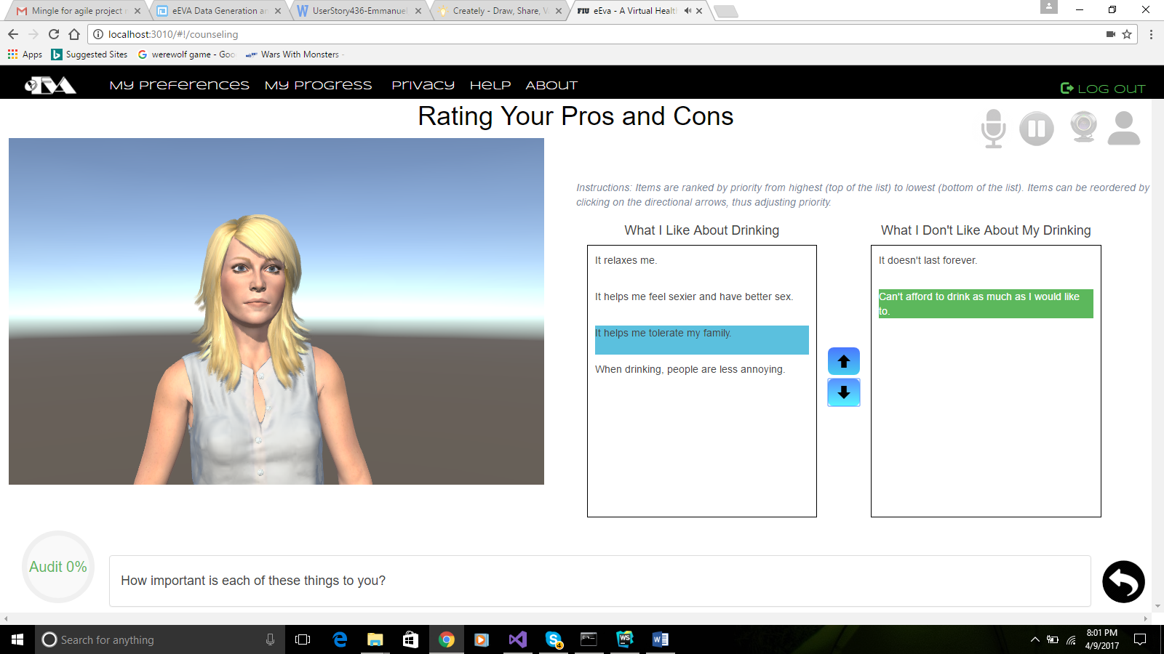
#425 EditDCU_AddDirectionalArrows
Notes:
As with all previous surveys, the counselor remains toggled at half screen.
The surveys that allow the user to move items either left and right (e.g. Not so good things revisited) or up and down (e.g. Rating Pros and Cons) now displays the functional arrows statically on the screen.
20 seconds
The tile of user story
Please present and show the complexity of your work, code, algorithms, and technical challenges and technologies you have used. (you could use screenshot if you want. Visual presentations are better than text presentation) - Go into the details of the most important/significant tasks using bullet lists or visual graphs or state chart diagram - Demo using screenshots or GIF (in another separate page if required)
Sequence Diagram for this user story is optional

Slide 13
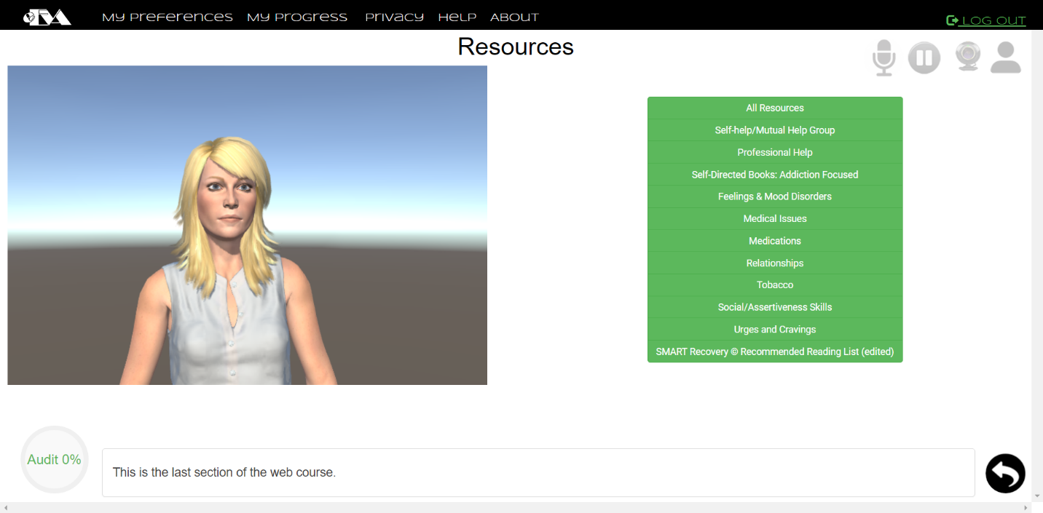
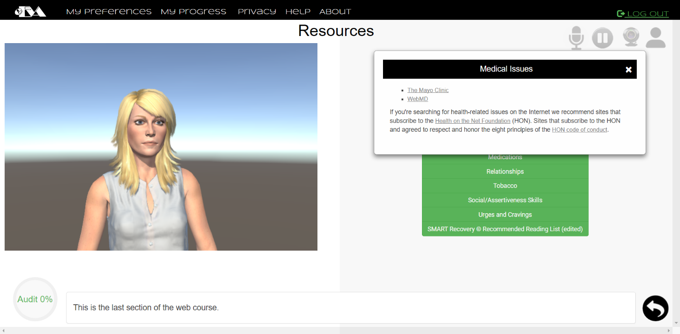
#436 EditDCU_Resources
Notes:
This section should provides a means by which the user can view all available resources at once by clicking on the All Resources button.
In contrast the resources provided to the user can be accessed by topic via the appropriate button.
This section also provides external links that open when clicked in an external tab within the user’s browser.
20 seconds
The tile of user story
Please present and show the complexity of your work, code, algorithms, and technical challenges and technologies you have used. (you could use screenshot if you want. Visual presentations are better than text presentation) - Go into the details of the most important/significant tasks using bullet lists or visual graphs or state chart diagram - Demo using screenshots or GIF (in another separate page if required)
Sequence Diagram for this user story is optional

Slide 14
eEVA Sample Test Cases
eEVA_IT_InitialCounselorSelection_01 (Sunny Day)
Purpose | To test that once the user clicks the “Next” button on the initial counselor selection page, the selected counselor will load and the counseling session will begin with a brief introduction.
Precondition | The user must have logged on, then from the current welcome page, the user has clicked the “Counseling” tab located in the navbar, the user has made a selection, and lastly the user has clicked next
Expected Result | The counseling session loads with the user’s selected counselor
Actual Result | The counseling session loaded with the user’s selected counselor
Status | Passed
eEVA_IT_InitialCounselorSelection_02 (Rainy Day)
Purpose | To test that when the user clicks a counselor thumbnail on the counselor selection page, the counseling session does NOT begin, i.e., the page does not redirect and the user is kept on the initial counselor selection.
Precondition | The user must have logged on, then from the current welcome page, the user has clicked counseling
Expected Result | The counseling session does not load
Actual Result | The counseling session DID NOT load
Status | Passed
Notes:
10 seconds
A description of verification process and Test Suites and Test Cases for one of the use cases.
1 One sunny day and one rainy day for the implemented use cases (one or more slides).
2 Automated test scripts for the implemented use cases (if any) (one or more slides).

Slide 15






In Summary
MEAN Stack Implementation to produce Survey Editor and State Machine (ASCL)
We worked on the following:
Counselor selection menus (initial and in session)
The remaining sections of the DCU
Utilized Agile, with daily Scrum meetings, and biweekly sprints
Additional Programs:
Mingle used to track progress
Github used to share portions of code
Google Drive used for Feature Documentation and to track Meetings
Notes:
10 seconds
Summarize your contribution, mention your effort for Scrum, Mingle, Github, Google Drive Documentation and minutes
Include your contact information
Ask if anyone has any questions for you.
Thank your audience

